Slide 1

Mini Project-II (K24MCA18P) Even Semester Session 2024-25
VAARTA – Real-Time Chat Application
Abhishek Mishra 202410116100008
Abhijeet Singh 202410116100007
Abhi Srivastav 202410116100006
Aayush Sharma 202410116100005
Project Supervisor:
Dr. Vipin Kumar
Associate Professor

Slide 2
Content
Introduction (1 slide)
Literature Review (2 slides)
Objective of the Project (1 slide)
Technology
Hardware Requirements (Development Environment, Server requirement (if required), Client requirement (if required).
Software Requirements (Language and Platforms like Frameworks, VS code, Android Studio and Jupyter notebook etc. )
Modules (2-3 slides)
Workflow (1 slide)
Reports (For Example: Project : Student Monitoring System, so reports like: Student Marks, Subjects, companies visit, and student appears in placement etc.)
References (1 slide)
Notes:
Font Styles: Times New Roman + Font Size: 25

Slide 3
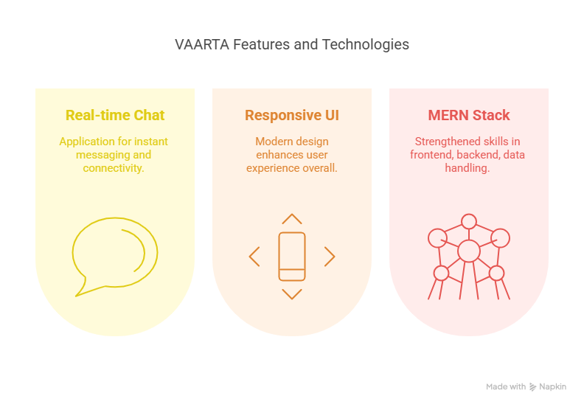
Introduction
VAARTA is a real-time chat application designed for instant messaging, seamless connectivity, and enhanced user engagement.
It enables users to send text, images, and multimedia files.
A modern, responsive UI for enhanced user experience.
Built using the MERN Stack , this project helped us strengthen our technical skills in frontend, backend and real-time data handling.
Notes:
Font Styles: Times New Roman + Font Size: 25

Slide 4
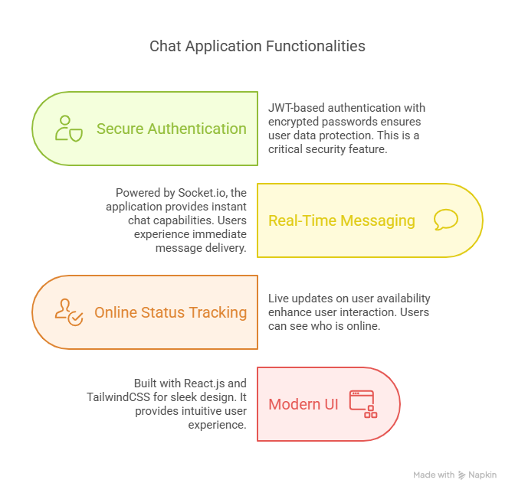
Literature Review
Overview of Existing Systems
Modern chat applications provide real-time messaging, secure authentication, and seamless user interaction. They enhance communication through instant updates, multimedia sharing, and online status tracking.
Key Functionalities Include:
Secure Authentication: JWT-based authentication with encrypted passwords.
Real-Time Messaging: Powered by Socket.io for instant chat.
Online Status Tracking: Live updates on user availability.
Modern UI : Built with React.js, TailwindCSS.
Technological Trends:
WebSockets for real-time communication.
Enhanced Security with encryption & authentication.
Notes:
Font Styles: Times New Roman + Font Size: 25

Slide 5
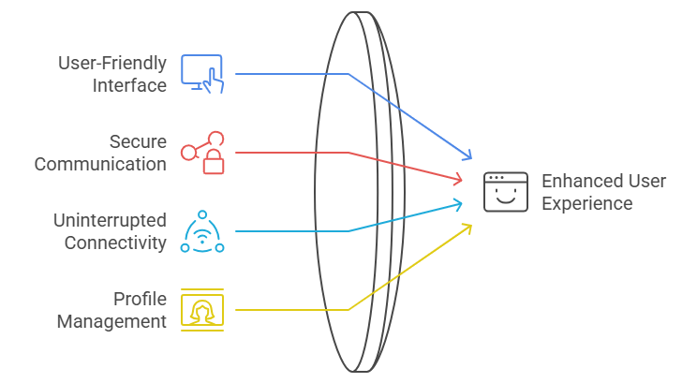
Objective of the Project
Instant Messaging: Enable real-time text communication without delays.
User-Friendly Interface: Provide a simple design for smooth interaction.
Secure Communication: Ensure data privacy and secure login authentication.
Uninterrupted Connectivity: Allow users to stay connected across different devices.
Profile Management: Let users create, update, and personalize their profiles.
Notes:
Font Styles: Times New Roman + Font Size: 25

Slide 6
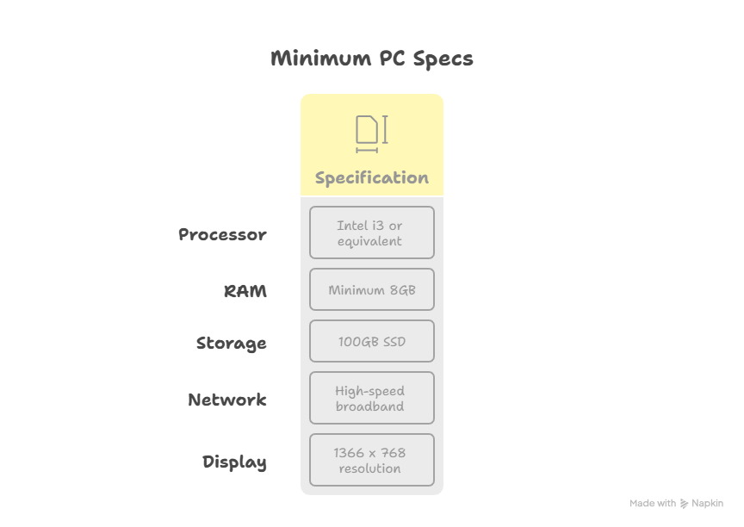
Hardware Requirements
. Processor: Intel i3 or equivalent
RAM: Minimum 8GB
Storage: 100GB SSD
Network: High-speed broadband
Display: 1366 x 768 resolution
Notes:
Font Styles: Times New Roman + Font Size: 25

Slide 7
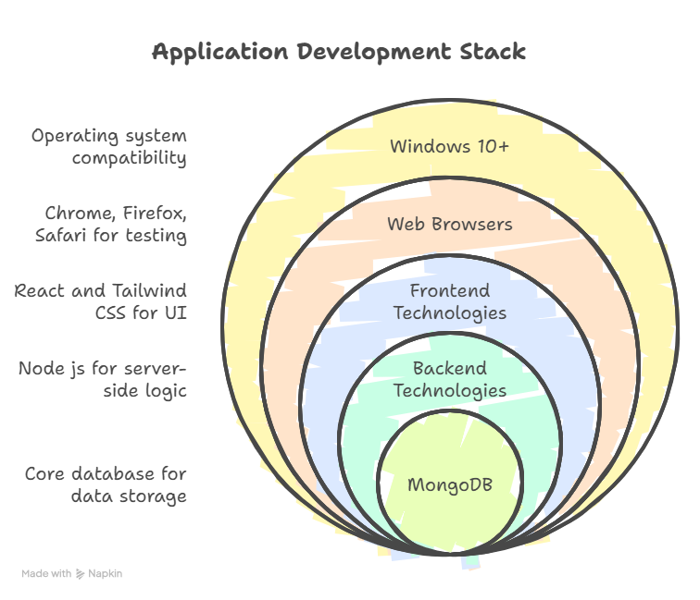
Software Requirements
Operating System:
Windows 10 or later
Frontend Technologies:
React
Tailwind CSS
Backend:
Node js
MongoDB
Database:
MongoDB (NoSQL) for data storage and management
Web Browser:
Latest version of Google Chrome, Firefox, or Safari for testing and running the application
Notes:
Font Styles: Times New Roman + Font Size: 25

Slide 8
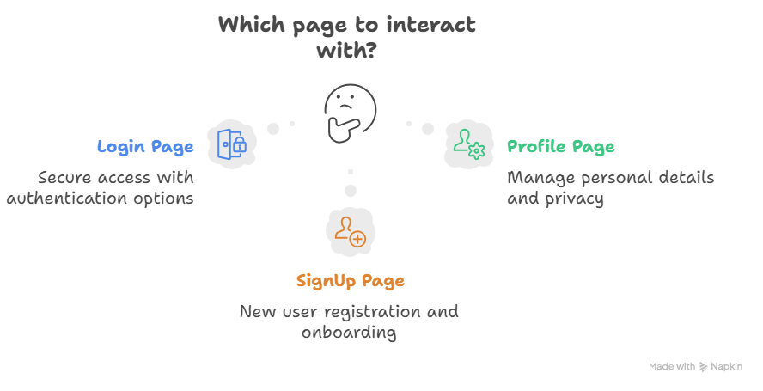
Modules
Home Page – Displays recent chats, contacts, and notifications with quick access to search and settings.
Login Page – Secure login with email/password or OTP, including multi-factor authentication and account recovery options.
Profile Page – Allows users to update profile details, manage privacy settings, and view account info.
SignUp Page – New user registration with OTP verification, profile setup, and seamless onboarding.
Notes:
Font Styles: Times New Roman + Font Size: 25

Slide 9
Reports
Vaarta Application
Introduction: VAARTA is a secure and real-time communication platform offering seamless messaging, voice, and video calling. It ensures privacy, real-time synchronization, and multi-platform support for both individuals and businesses.
Objectives:
Provide real-time messaging.
Ensure secure authentication login.
Enable instant message delivery and live status updates.
Technologies Used:
Frontend: React.js (Web), Tailwind CSS.
Backend: Node.js.
System Design:
User Authentication: Secure login, role-based access.
Messaging System: Text, voice, and video chat with real-time sync.
Group & Media Sharing: Support for group chats, file & media transfer.
Notes:
Font Styles: Times New Roman + Font Size: 25

Slide 10
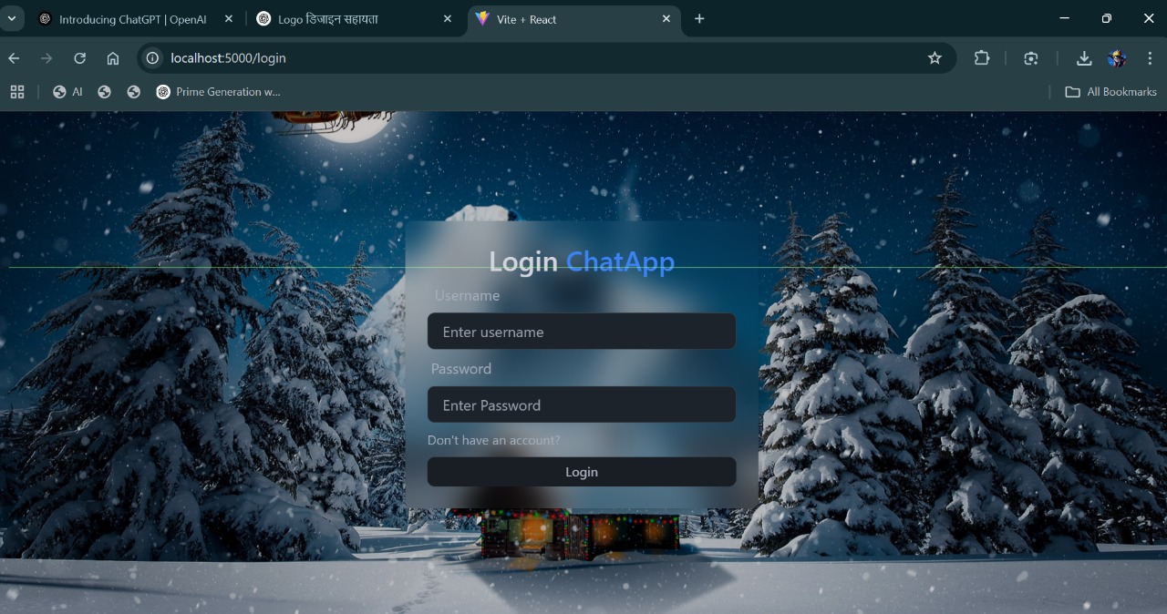
Project Overview:

Slide 11
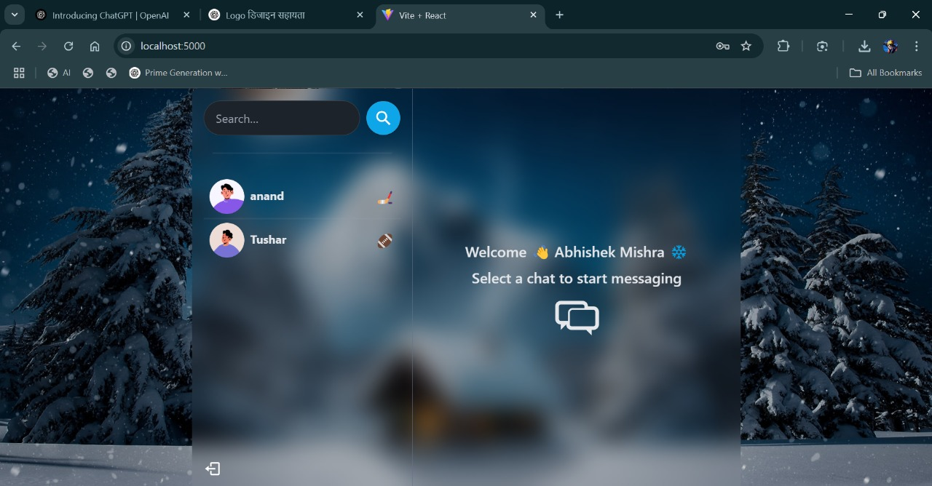
Project Overview: Cont…..

Slide 12
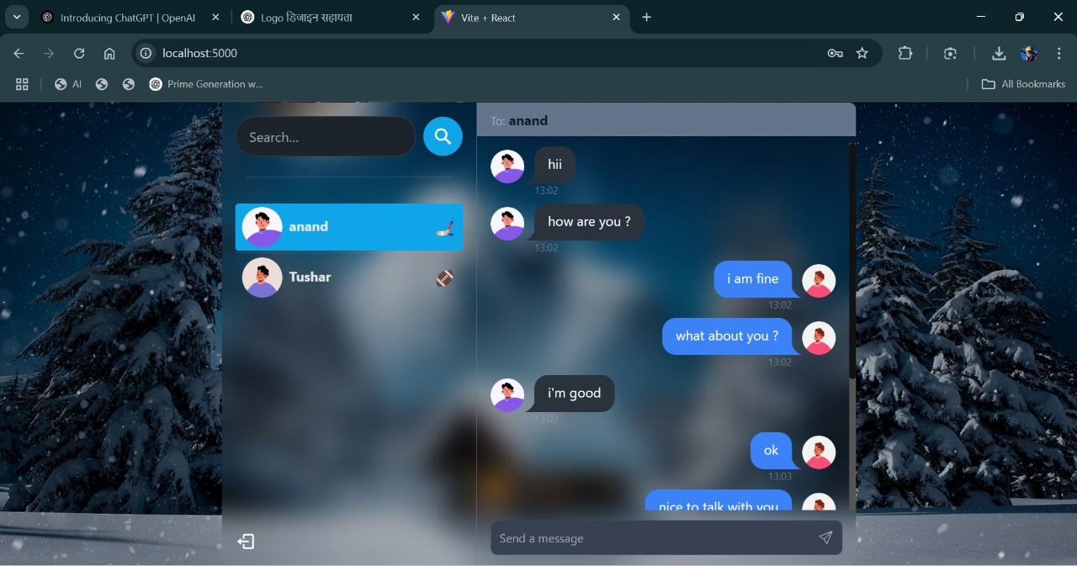
Project Overview:

Slide 13
References
MongoDB Documentation – https://www.mongodb.com/docs/manual/
Node.js & Express.js Guides – https://expressjs.com/
React & TailwindCSS Documentation – https://react.dev/ | https://tailwindcss.com/docs
JWT Authentication Guide – https://jwt.io/introduction/
Notes:
Font Styles: Times New Roman + Font Size: 25

